Slide 1
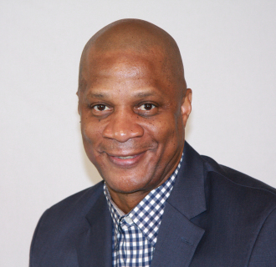
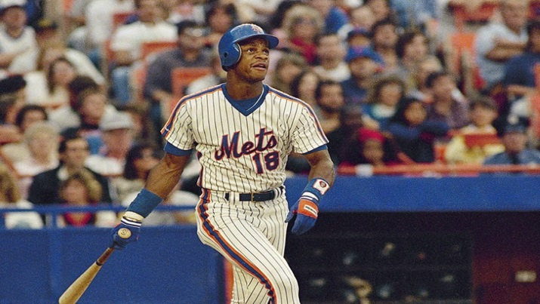
Baseball Legend Darryl Strawberry
presents
Wednesday, July 11, 7:30pm
Mount Vernon Nazarene University 800 Martinsburg Road, Mount Vernon, OH 43050
Former Rookie of the Year and four-time World Series champion will share his incredible testimony of healing through a relationship with Christ.
www.ncodistrict.org

